Slide 1

TOPIC:
Shift Registers
(Lectures - 3-4)
Dr. Jyoti
Asst. Prof. (DICE)

Slide 2
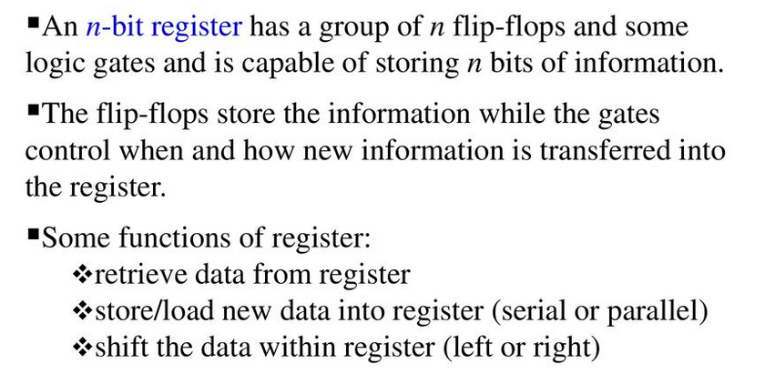
Shift Register
The Shift Register is another type of sequential logic circuit that can be used for the storage or the transfer of binary data

Slide 3
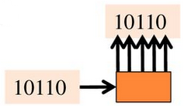
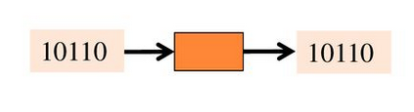
Shift Register
Serial-in to Parallel-out (SIPO) - the register is loaded with serial data, one bit at a time, with the stored data being available at the output in parallel form.
Serial-in to Serial-out (SISO) - the data is shifted serially “IN” and “OUT” of the register, one bit at a time in either a left or right direction under clock control.

Slide 4
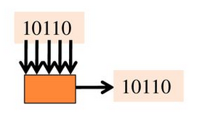
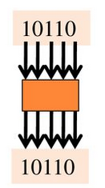
Shift Register
Parallel-in to Serial-out (PISO) - the parallel data is loaded into the register simultaneously and is shifted out of the register serially one bit at a time under clock control.
Parallel-in to Parallel-out (PIPO) - the parallel data is loaded simultaneously into the register, and transferred together to their respective outputs by the same clock pulse.

Slide 5
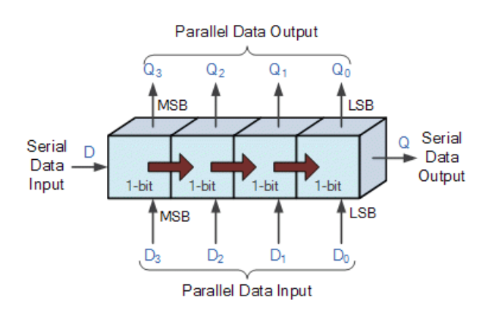
Shift Register

Slide 6
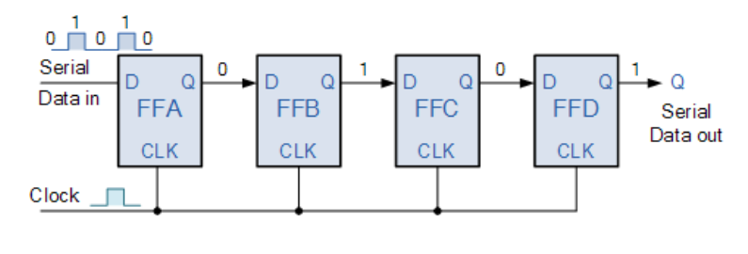
Shift Register
Serial-in to Serial-out (SISO) Shift Register
4-bit Serial-in to Serial-out Shift Register

Slide 7
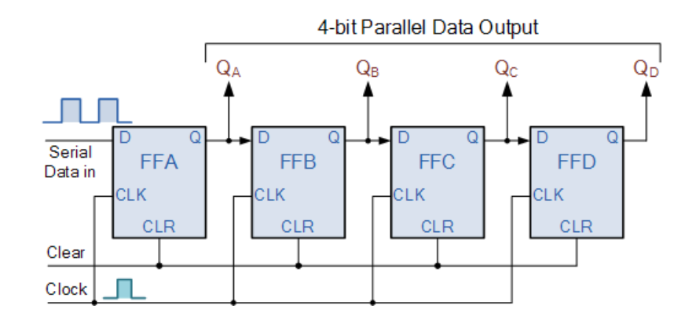
Shift Register
Serial-in to Parallel-out (SIPO) Shift Register
4-bit Serial-in to Parallel-out Shift Register

Slide 8
Shift Register
Serial-in to Parallel-out (SIPO) Shift Register
Clock Pulse No | QA | QB | QC | QD
0 | 0 | 0 | 0 | 0
1 | 1 | 0 | 0 | 0
2 | 0 | 1 | 0 | 0
3 | 0 | 0 | 1 | 0
4 | 0 | 0 | 0 | 1
5 | 0 | 0 | 0 | 0
Basic Data Movement Through A Shift Register

Slide 9
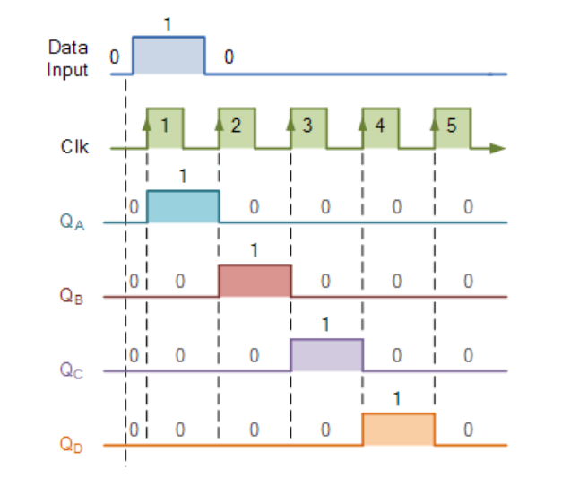
Shift Register
Serial-in to Parallel-out (SIPO) Shift Register

Slide 10
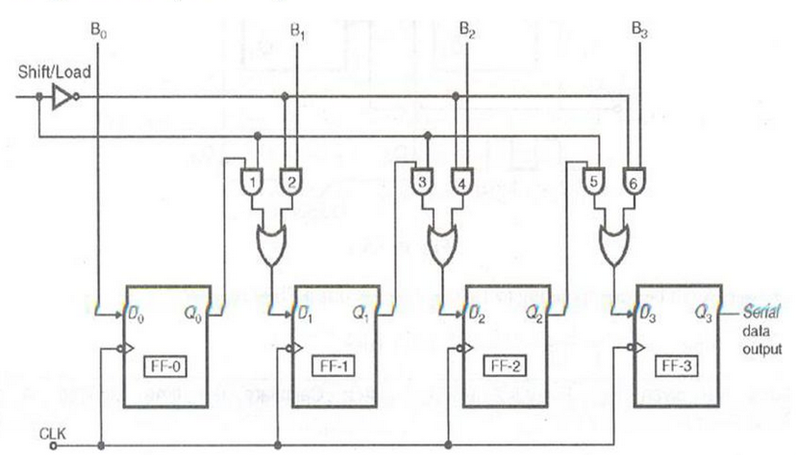
Shift Register
Parallel-in to Serial-out (PISO) Shift Register
4-bit Parallel-in to Serial-out Shift Register

Slide 11
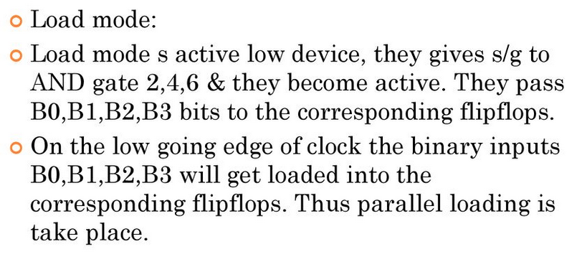
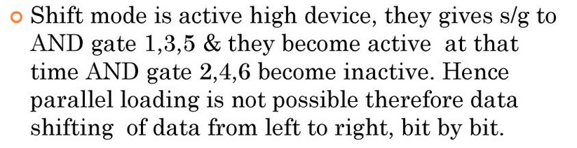
Shift Register
Parallel-in to Serial-out (PISO) Shift Register
Load Mode
Shift Mode

Slide 12
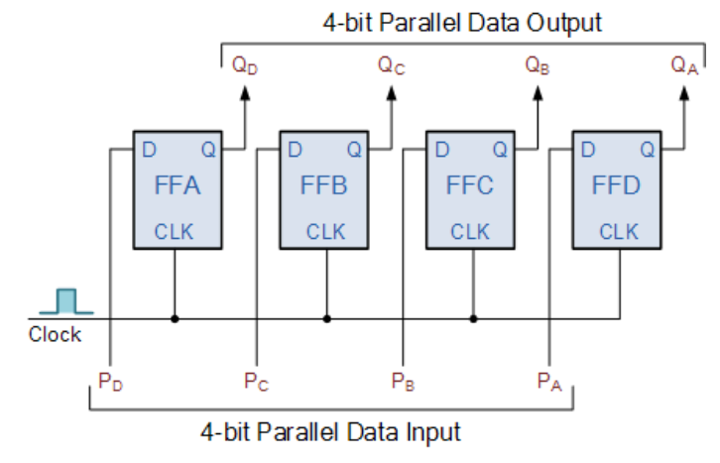
Shift Register
Parallel-in to Parallel-out (PIPO) Shift Register
4-bit Parallel-in to Parallel-out Shift Register

Slide 13
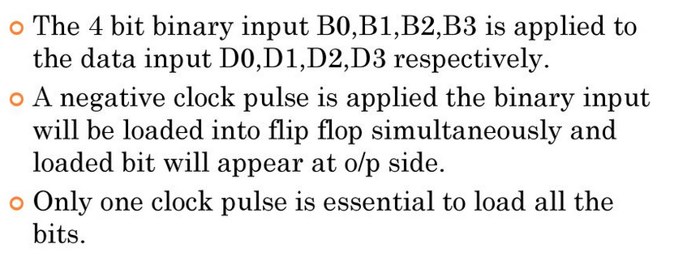
Shift Register
Parallel-in to Parallel-out (PIPO) Shift Register

Slide 14
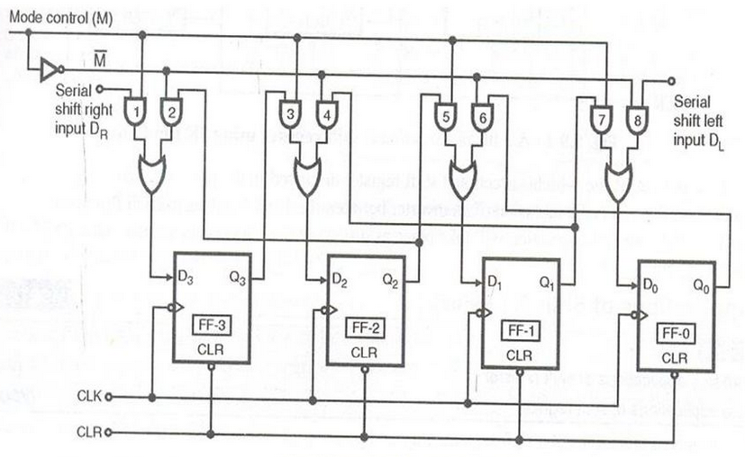
Shift Register
Bidirectional Shift Register

Slide 15
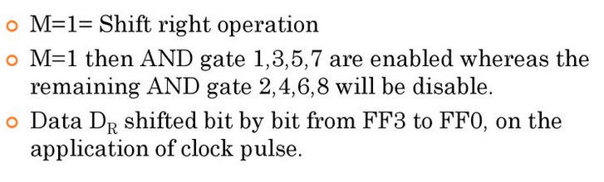
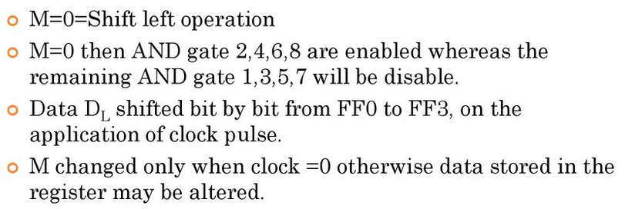
Shift Register
Bidirectional Shift Register
Shift Right Operation
Shift Left Operation

Slide 16
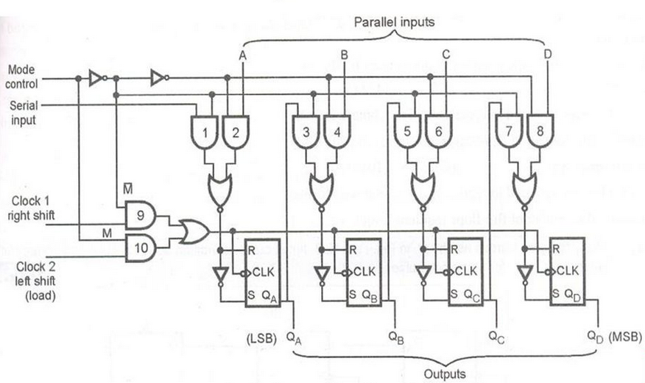
Shift Register
Universal Shift Register

Slide 17
Shift Register
Universal Shift Register
The universal shift register can be defined as “The register which can be used to shift the data in both the directions like left, right and can load parallel data as well”.
This register can perform three types of operations, stated below.
Parallel loading
Shifting left
Shifting right

Slide 18
Shift Register
Applications of Shift Registers
1. Registers are used in digital electronic devices like computers as
Temporary data storage
Data transfer
Data manipulation
As counters
2. Shift registers are used in computers as memory elements.
3. Shift registers are used for counter designing.

Slide 19
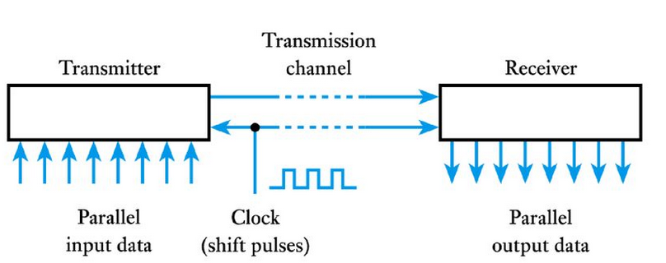
Shift Register
Applications of Shift Registers
An application of Shift register in serial/parallel and parallel/serial conversion used in serial communication

Slide 20
Shift Register
Applications of Shift Registers
Serial in – serial out register are used for time delays.
The time delay can be calculated by using below formula.
Δt = N * 1 / fc
Where N represents number of stages / flip flops and fC represents clock frequency.
Serial in – parallel out registers are used for converting the data from serial form to parallel form. So these are also called “Serial to parallel converters”.
Parallel in – serial out registers are used for converting the data from parallel form to serial form. So these are also called “Parallel to serial converters”.

